Slide 1
Chapter 6: Software Quality Assurance (SQA) Process
Ensuring High-Quality, Reliable, and Standard-Compliant Software

Slide 2
What is Software Quality?
📝 Concept:
✔ Software Quality refers to the degree to which a software product meets customer expectations, functional requirements, and performance goals. ✔ Ensures efficiency, usability, maintainability, security, and reliability.
✅ Why is Software Quality Important? 🔹 Prevents bugs & failures 🐞 🔹 Ensures customer satisfaction 😊 🔹 Reduces maintenance costs 💰

Slide 3
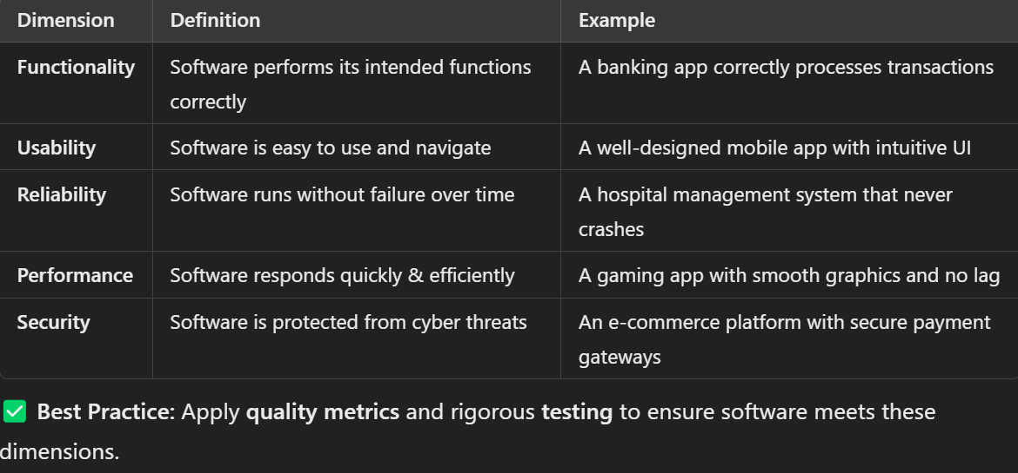
Key Dimensions of Software Quality

Slide 4
What is Software Reliability?
📝 Concept:
✔ Software Reliability measures the probability that software will function correctly over a given period of time under specific conditions. ✔ It is one of the most important factors in Software Quality Assurance (SQA).
📌 Factors Affecting Software Reliability
✅ Fault Tolerance: Can the system recover from failures? ✅ Mean Time Between Failures (MTBF): How frequently does the software fail? ✅ Error Rate: How many bugs are found after release?
💡 Example:
📌 A banking application should never fail during a transaction. Even if it crashes, it should restore the transaction safely without loss of funds.
✅ Best Practice: Use automated error detection, redundancy, and recovery mechanisms to enhance reliability.

Slide 5
Software Quality Management & Planning
What is Software Quality Management (SQM)?
📝 Concept:
✔ Software Quality Management (SQM) ensures that software meets defined quality standards through proper planning, control, and assurance mechanisms. ✔ It consists of three key areas:
🔹 Three Pillars of SQM
1️⃣ Quality Planning → Define quality objectives & processes. 2️⃣ Quality Assurance (QA) → Prevent defects with structured processes. 3️⃣ Quality Control (QC) → Identify & fix defects using testing techniques.

Slide 6
Software Quality Planning Process
📌 Software Quality Planning ensures quality is built into software from the start, not just tested at the end.
✅ Steps in Quality Planning: 1️⃣ Define Quality Standards → What does "high quality" mean for this software? 2️⃣ Identify Key Metrics → Example: Response Time < 1 sec, Crash Rate < 0.1%. 3️⃣ Create a Quality Assurance Plan → How will quality be ensured? 4️⃣ Implement a Testing Strategy → Manual & Automated Testing. 5️⃣ Monitor and Improve Continuously → Apply feedback loops to enhance quality.
💡 Example: Google’s Android OS undergoes strict quality planning before every major release to ensure performance, security, and compatibility.
✅ Best Practice: Use Agile Testing & Continuous Integration (CI/CD) for ongoing quality checks.

Slide 7
Why Are Software Standards Important?
📝 Concept:
✔ Software Standards ensure that software products are developed, tested, and maintained consistently across industries. ✔ Compliance with standards improves software quality, security, and reliability.
✅ Benefits of Software Standards: 🔹 Reduces risks (prevents security vulnerabilities) 🔐 🔹 Ensures compatibility across platforms 🌍 🔹 Maintains industry best practices 📏

Slide 8
ISO (International Organization for Standardization)
✔ ISO 9001: Ensures general quality management across industries. ✔ ISO 25010: Defines software product quality models. ✔ ISO 27001: Focuses on software security & data protection.
💡 Example: 📌 Microsoft Windows follows ISO 25010 to ensure high performance and security across all updates.

Slide 9
CMMI (Capability Maturity Model Integration)
✔ CMMI is a framework used to improve software development processes. ✔ Maturity Levels (1 to 5):
1️⃣ Initial → No structured process (ad-hoc development). 2️⃣ Managed → Basic project management exists. 3️⃣ Defined → Standardized development processes. 4️⃣ Quantitatively Managed → Uses data-driven decisions. 5️⃣ Optimized → Continuous process improvement.
💡 Example: 📌 NASA and IBM follow CMMI Level 5 for high-reliability software (e.g., Spacecraft navigation).
✅ Best Practice: Large organizations follow CMMI & ISO standards to deliver high-quality, error-free software.

Slide 10
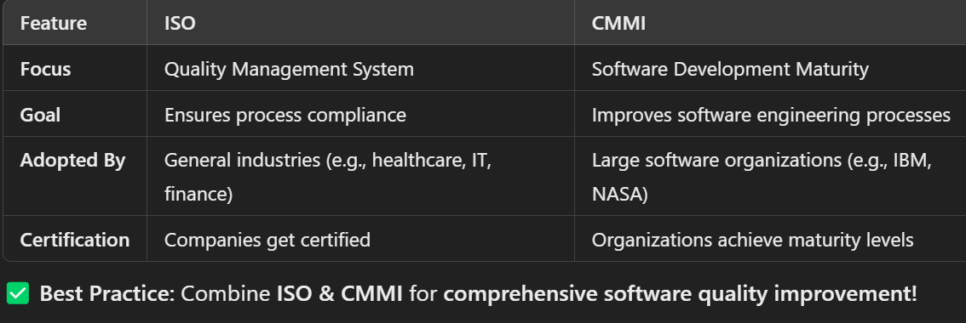
Comparison - ISO vs. CMMI

Slide 11
Capability Assessment and Process Improvement
What is Capability Assessment?
📝 Concept:
✔ Capability Assessment measures an organization’s ability to develop and maintain high-quality software. ✔ It helps identify weaknesses, inefficiencies, and areas for improvement. ✔ Used in Software Process Improvement (SPI) frameworks like CMMI, ISO 15504 (SPICE)-(Software Process Improvement and Capability Determination), and Six Sigma.

Slide 12
Software Process Improvement (SPI)
📝 Concept:
✔ Software Process Improvement (SPI) refers to activities that enhance software development quality, efficiency, and predictability. ✔ Based on continuous feedback and assessments.
✅ Key Steps in SPI: 1️⃣ Assess Current Processes → Identify areas needing improvement. 2️⃣ Define Improvement Goals → Set measurable objectives. 3️⃣ Implement Changes → Modify development & testing processes. 4️⃣ Monitor and Evaluate → Ensure changes produce positive results.
💡 Example: 📌 Google's DevOps Transformation 🔹 Shifted from traditional development to Continuous Integration/Continuous Deployment (CI/CD), improving efficiency and reliability.
✅ Best Practice: Use agile methodologies & automated testing for continuous process improvement.

Slide 13
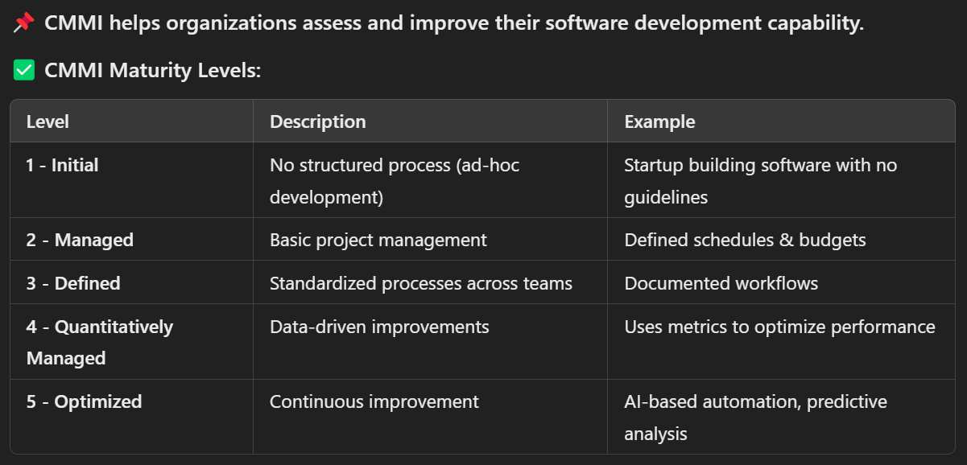
Capability Maturity Model Integration (CMMI) for Process Improvement

Slide 14
What are Software Process Standards?
📝 Concept:
✔ Process Standards define how software development should be conducted to ensure consistency, efficiency, and quality. ✔ Helps companies follow best practices and reduce risks.
✅ Key Examples of Software Process Standards: 1️⃣ ISO 9001 → Quality management system for software organizations. 2️⃣ CMMI → Defines software development maturity levels. 3️⃣ Agile & DevOps Best Practices → Promotes iterative & automated software development.
💡 Example: 📌 Amazon Web Services (AWS) follows ISO 27001 to ensure secure cloud computing standards.
✅ Best Practice: Follow standardized processes to increase efficiency & maintain compliance.

Slide 15
What are Software Product Standards?
📝 Concept:
✔ Product Standards ensure software products meet functional, security, and usability requirements. ✔ Focuses on the end-user experience rather than just development processes.
✅ Key Product Standards: 1️⃣ ISO 25010 → Defines software quality characteristics (performance, security, usability). 2️⃣ IEEE 829 → Standard for test documentation. 3️⃣ ISO 27001 → Focuses on data security & encryption.
💡 Example: 📌 Microsoft Windows follows ISO 25010 for usability & performance testing before every release.
✅ Best Practice: Use industry standards to improve software reliability & customer satisfaction.

Slide 16
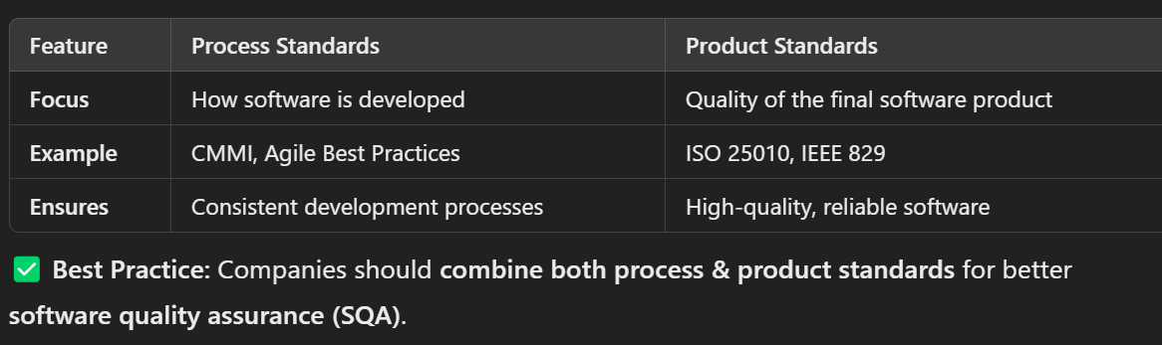
Difference Between Process and Product Standards

Slide 17
What are Software Reviews?
📝 Concept:
✔ Software Reviews involve systematically examining software requirements, code, or test cases to identify errors early. ✔ Helps reduce rework & improves software quality.
✅ Types of Software Reviews: 1️⃣ Informal Reviews → Developer discussions, peer feedback. 2️⃣ Technical Reviews → Conducted by technical experts to ensure design correctness. 3️⃣ Formal Reviews → Structured meetings for requirement validation, design verification, and test planning.
💡 Example: 📌 Google’s Code Review Process 🔹 Every change in the Chrome browser’s codebase is reviewed by multiple engineers before merging.
✅ Best Practice: Use peer reviews & automated code review tools (e.g., GitHub PR reviews).

Slide 18
What is Software Inspection?
📝 Concept:
✔ Software Inspection is a formal, structured review process used to detect defects early. ✔ Different from regular reviews because it follows a strict checklist & documentation process.
✅ Key Steps in Software Inspection: 1️⃣ Planning → Define the scope & objectives. 2️⃣ Preparation → Reviewers study the software artifacts. 3️⃣ Meeting → Discuss findings & document issues. 4️⃣ Rework → Fix defects identified during inspection. 5️⃣ Follow-up → Ensure fixes are properly implemented.
💡 Example: 📌 NASA uses rigorous software inspections for space mission software to prevent critical failures.
✅ Best Practice: Conduct early inspections to avoid costly fixes in later stages.

Slide 19
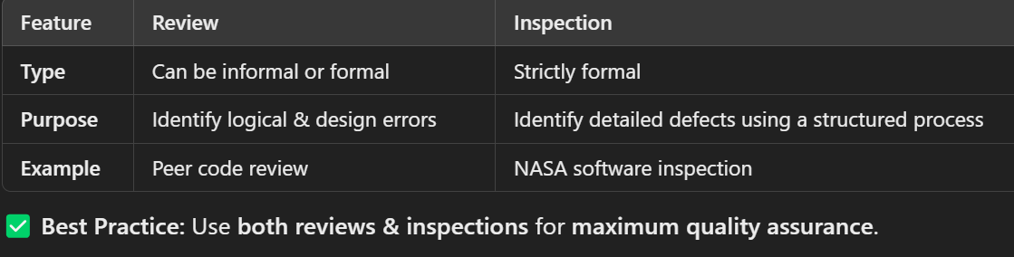
Difference Between Review & Inspection

Slide 20
Old Question Practice
What do you mean by Boundary Value Analysis (BVA) Testing? Consider the problem for the determination of the nature of roots of a quadratic equation. Its inputs are a triple of positive integers (say a, b, and c) and values may be from the interval [0,100]. The output may have one of the following words:
Not a quadratic equation
Real roots
Imaginary roots
Equal roots
Identify the Boundary Value Analysis (BVA) test cases.

Slide 21

Answer:
Boundary Value Analysis (BVA) is a black-box testing technique that focuses on testing input boundary values where errors are most likely to occur. Instead of testing random values, we test minimum, maximum, just below, just above, and valid boundary values.
For this problem, the quadratic equation is of the form:

Slide 22
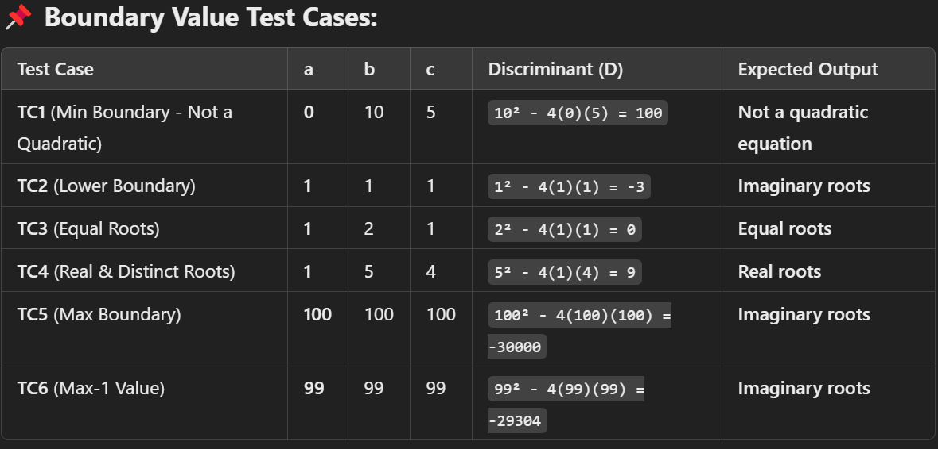
📌 Identifying Boundary Values:
Since the input values a, b, c range from 0 to 100, the key boundaries to consider are:
Lower Bound: 0, 1
Upper Bound: 99, 100
Transition Points: D > 0, D = 0, D < 0

Slide 23
📌 Conclusion:
Boundary testing focuses on edge values where behavior might change.
The test cases cover all possible root types (Not quadratic, Real, Imaginary, Equal).
Ensures correctness by testing extreme values at both ends of the range.
✅ Final Thought: By applying Boundary Value Analysis (BVA), we minimize the number of test cases while ensuring maximum coverage of critical boundary points. 🚀

